Slide 1
RUG – Team Machine
2017.04.18 – Dan Ross-Li

Slide 2
“Lending Club’s platform has the potential to profoundly transform traditional banking over the next decade.”
-- Larry Summers, 71st Secretary of the Treasury of the United States of America; Lending Club Board member
Lending Club - MACHINE EARNINGS
Aaron Trent, Dan Ross-Li, Mike Buckley, Scott Katzbeck, Zack Fountas
All Slides generously taken with consent for 757 RUG
Notes:
Scott

Slide 3
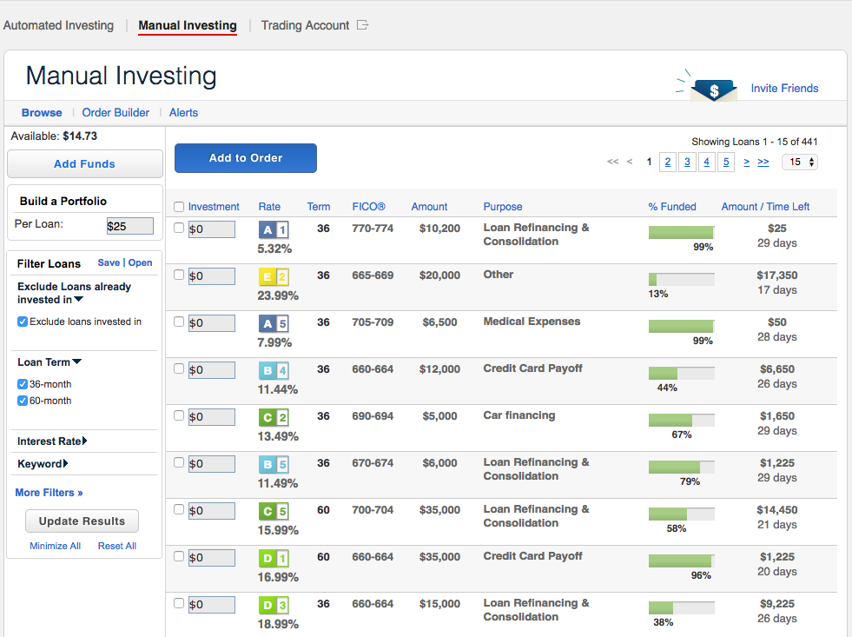
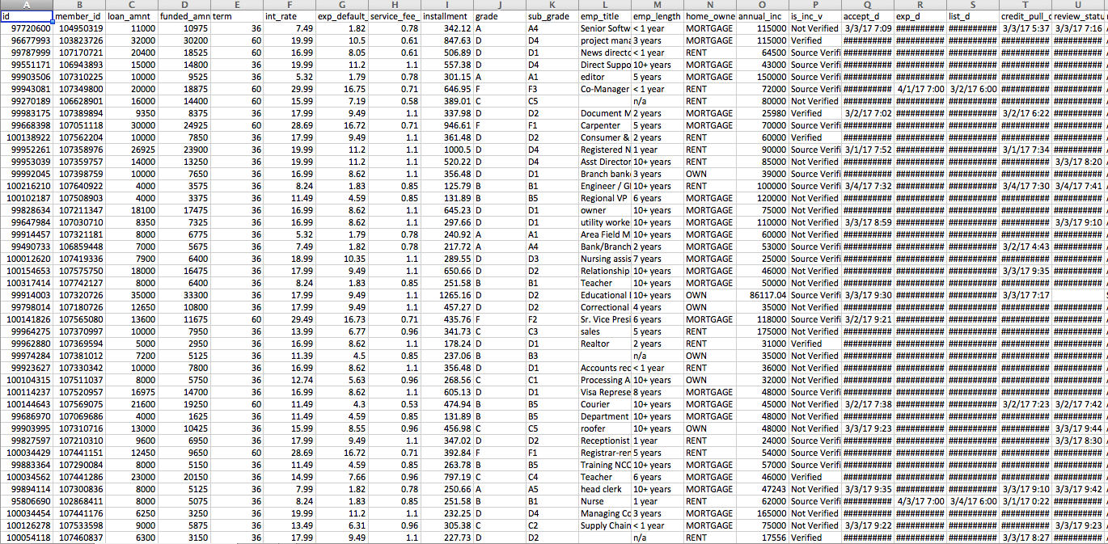
Lending Club Background
Founded in 2006 after Prosper (2005); went public in 2014
World’s largest online credit marketplace; over $22 billion invested
Facilitates personal and business loans
Allows borrowers to access lower rates through a fast, online process
Investors provide capital and can create a “diversified” portfolio of loans
Large retail investor base and growing institutional interest from banks, dedicated funds, asset managers, and pension funds
Scandal in 2016 forced CEO to step down; loan originations slowed as a result
Liquidity risk of platform remains open question (i.e., possibility that institutional investors pulling funds from marketplace)
Notes:
Mike

Slide 4
Goal
To create an investable prediction model for retail investors to forecast total returns of the loans available for purchase on the marketplace.
Retail investor can download spreadsheet of available loan data, run through prediction model, and identify loans that meet specific return targets.
Notes:
Mike

Slide 5
Details
Data Set
Publicly available data from the Lending Club website
Added data available to investors (members of Lending Club)
Loans issued from 2012-2014 - Only using completed loans
Target Variable
Annualized Total Returns
The total payment to investors (principal + interest) less collection fees on an annualized basis
Predictors
68 loan application details and borrower characteristics, e.g.,
Lending Club loan “grade” (A, B, C, D, E, F, G)
Borrower home ownership status (own, rent, etc.)
Loan purpose (debt consolidation, home improvement, small biz, etc.)
FICO score range

Slide 6
Data Cleaning
Compare historical data to data available to investors
Drop identification and raw text variables
Exclude non-completed loans
Drop variables not available to investors at outset
Drop variables used to filter out non-completes and calculate returns
Identify NA's, deal with missingness (including mean imputation)
Check factor levels of categorical variables
Other data transformations, e.g. number of days between loan issue date and first credit line
Notes:
Zach

Slide 7
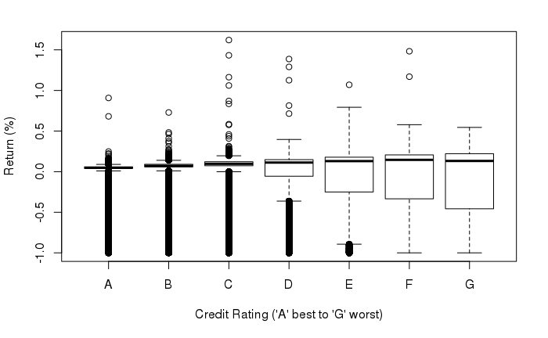
Data Exploration
Returns by Grade
Notes:
Zach

Slide 8
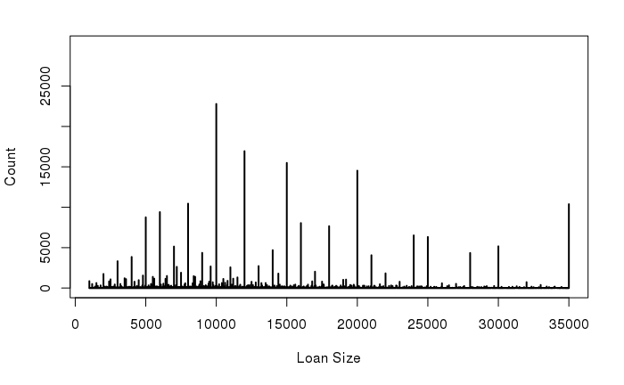
Data Exploration
Distribution by Size
Notes:
Zach

Slide 9
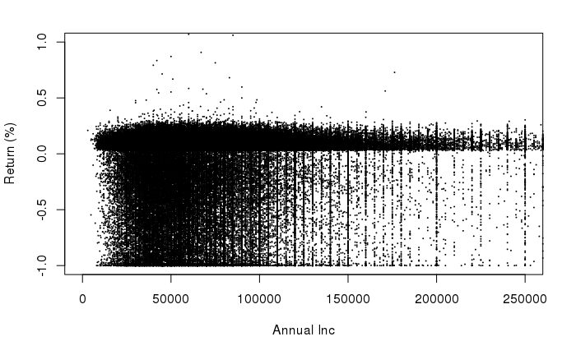
Data Exploration
Distribution by Income
Notes:
Zach

Slide 10
Data Analysis
What we used to explore the data set
Split the data between Training/ Test set
80% of the data for training & validation
20% of the data for testing
Simple linear regression
KNN
Random Forest
Boosting
Lasso
Notes:
Aaron

Slide 11

Booth ML LC HF Index
Outstanding Loans: >$4 Billion
LC Average Loan: -.003%
LC Average Loan Weight by size: 4.98%
MLLCHF: 7.65%
Notes:
Dan

Slide 12
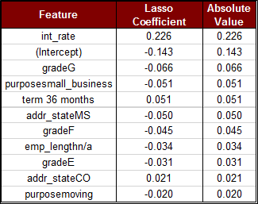
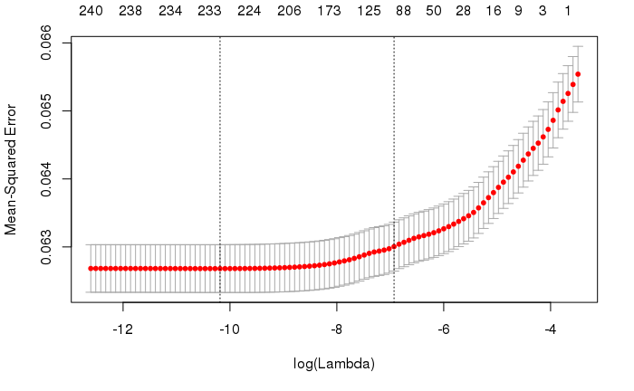
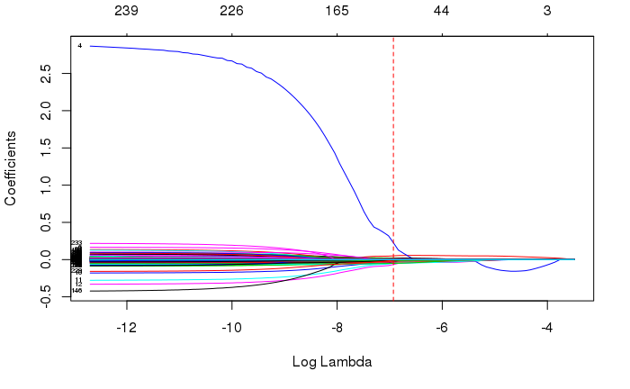
Results Lasso
Interpretable results
Largest coefficients on variables we would expect (e.g. interest rate, grade, employment length)
Overall prediction performance relatively poor
However, top 100 loans based on returns predicted under model would have generated 6.50% actual returns
Top 10 loans >9%
Notes:
Aaron

Slide 13
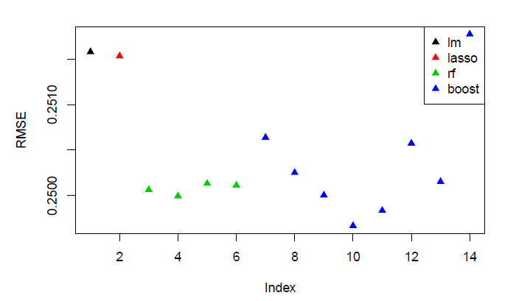
Results
RMSE
Notes:
Zach

Slide 14
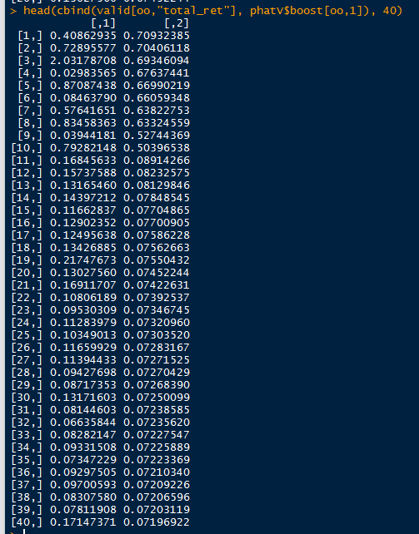
Results
Validation Returns
Notes:
Zach

Slide 15
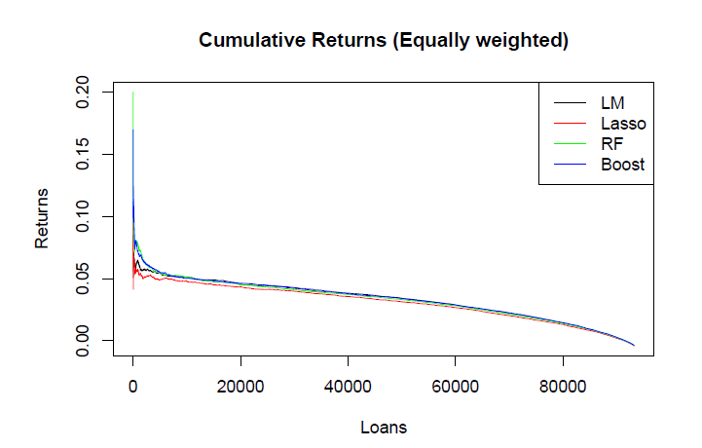
Results
Validation Returns
Notes:
Zach

Slide 16
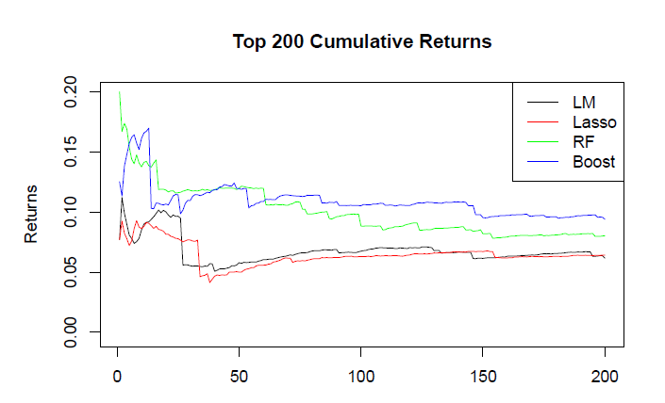
Results
Validation Returns
Notes:
Zach

Slide 17
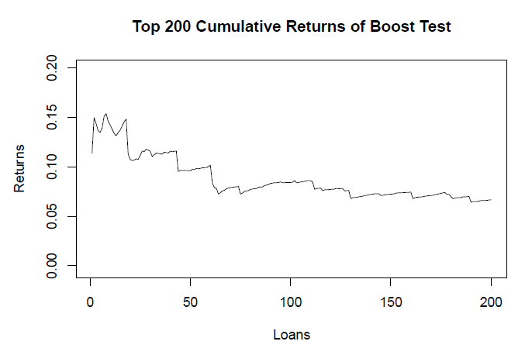
Results
Test Returns
Notes:
Zach

